Slide 1
DATA disguisable modus
By,
R121743
R121842

Slide 2
Overview:
Steganography
Types of Steganography
Image Steganography
LSB Technique
Designing in MATLAB
Applications
Future Scope

Slide 3
Steganography
practice of concealing a file, message, image, or video within another file, message, image, or video.
word steganography combines the Greek words steganos , meaning "covered, concealed, or protected," and graphein meaning "writing“.

Slide 4
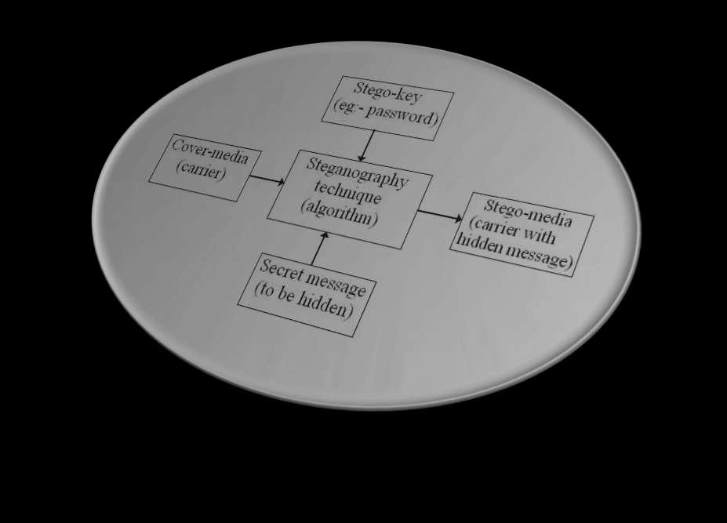
Block diagram- Steganography:

Slide 5
Types of Steganography :
Four types :
Messages in text
Messages in images
Messages in audio
Messages in video

Slide 6
Data flow:
Carrier to Matrix
Embedded Process
Source Data
Matrix to Carrier
Final Extraction

Slide 7
Image Steganography:
hiding the data within the image ,that prevents the unintended user from the detection of the hidden messages or data.
-- Carrier – Image
--Source – Text
Methods:-
PI (Pixel indicator)
SCC (Stego Color Cycle)
Triple-A
Max-Bit
LSB (Least Significant Bit)

Slide 8
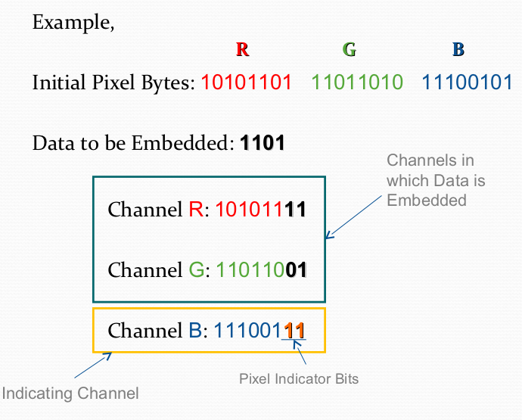
Pixel Indicator:
uses the least two significant bits of one of the channels to indicate existence of data in the other two channels

Slide 9
Stego Color Cycle:
Uses the RGB images to hide the data in different channels.
Keeps the hidden data in cycling manner to channels.
Triple-a:
consider more randomization of bits and channels.
Two modes:
1. To determine the used channels
2. To determine the number of bits used

Slide 10
Max - bit:
Based on intensity of the pixel and then hides data by random pixel selection with a goal to hide maximum data in each pixel.
Parts:
Image Intensity Calculation
Encryption

Slide 11
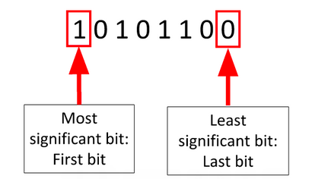
LSB Technique:
The LSB is the lowest significant bit in the byte value of the image pixel.
Embeds the secret in the least significant bits of pixel values of the cover image.

Slide 12
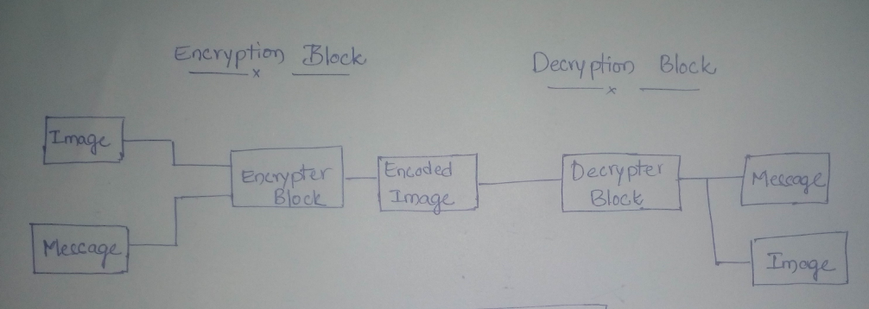
Block Diagram:

Slide 13
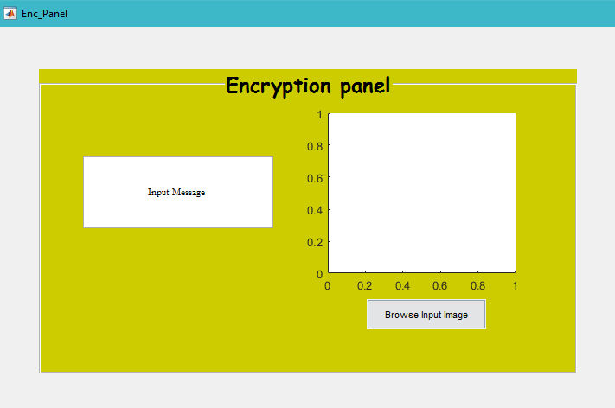
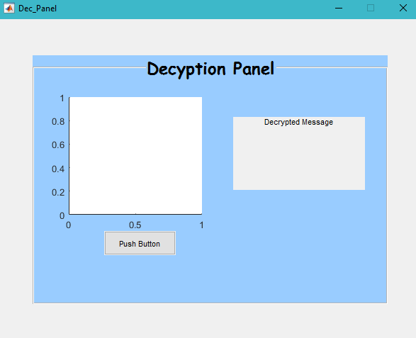
Using MATLAB:
Encryption Block:
Decryption Block:

Slide 14
Example:
Input message – h a i
ASCII conversion - 104 97 105
Binary conversion- 01101000 01100001 01101001

Slide 15
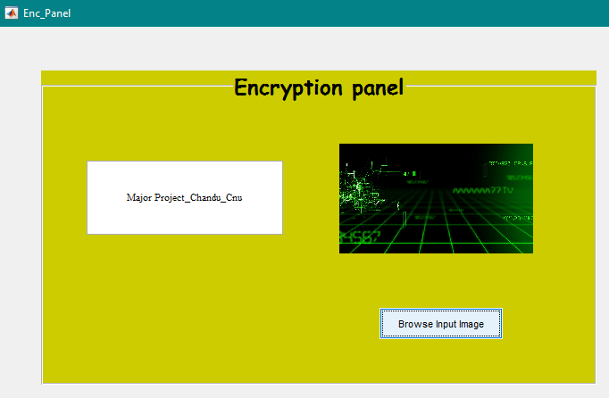
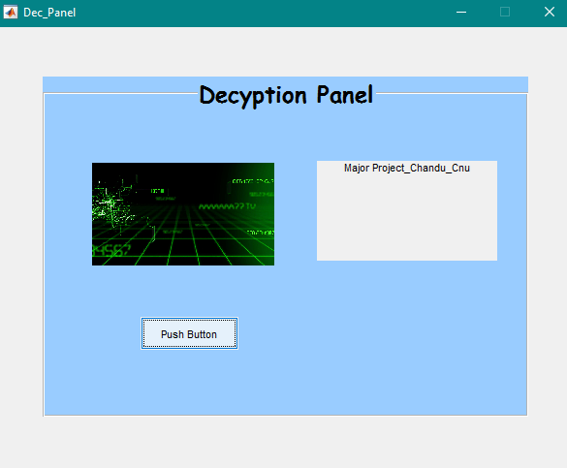
Samples:
Source Compilation
Decoded output

Slide 16
STEGANOGRAPHY Vs CRYPTOGRAPHY

Slide 17
Applications:
Confidential Communication and Secret data storing
Protection of Data alteration
Water Marking
Smart Identity cards
Digital Database Management

Slide 18
Future Scope:
criminal communications resistance.
Mitigating piracy by aiding improvement in copyright marking.
Even VoIP protocol to be effectively secured by Steganography.
Techniques to be improved such as LSB and other.

Slide 19
Thank You

